Slide 1
Final Project: Wrist Powered Prosthetic Device
By: Gabriel Benitez

Slide 2


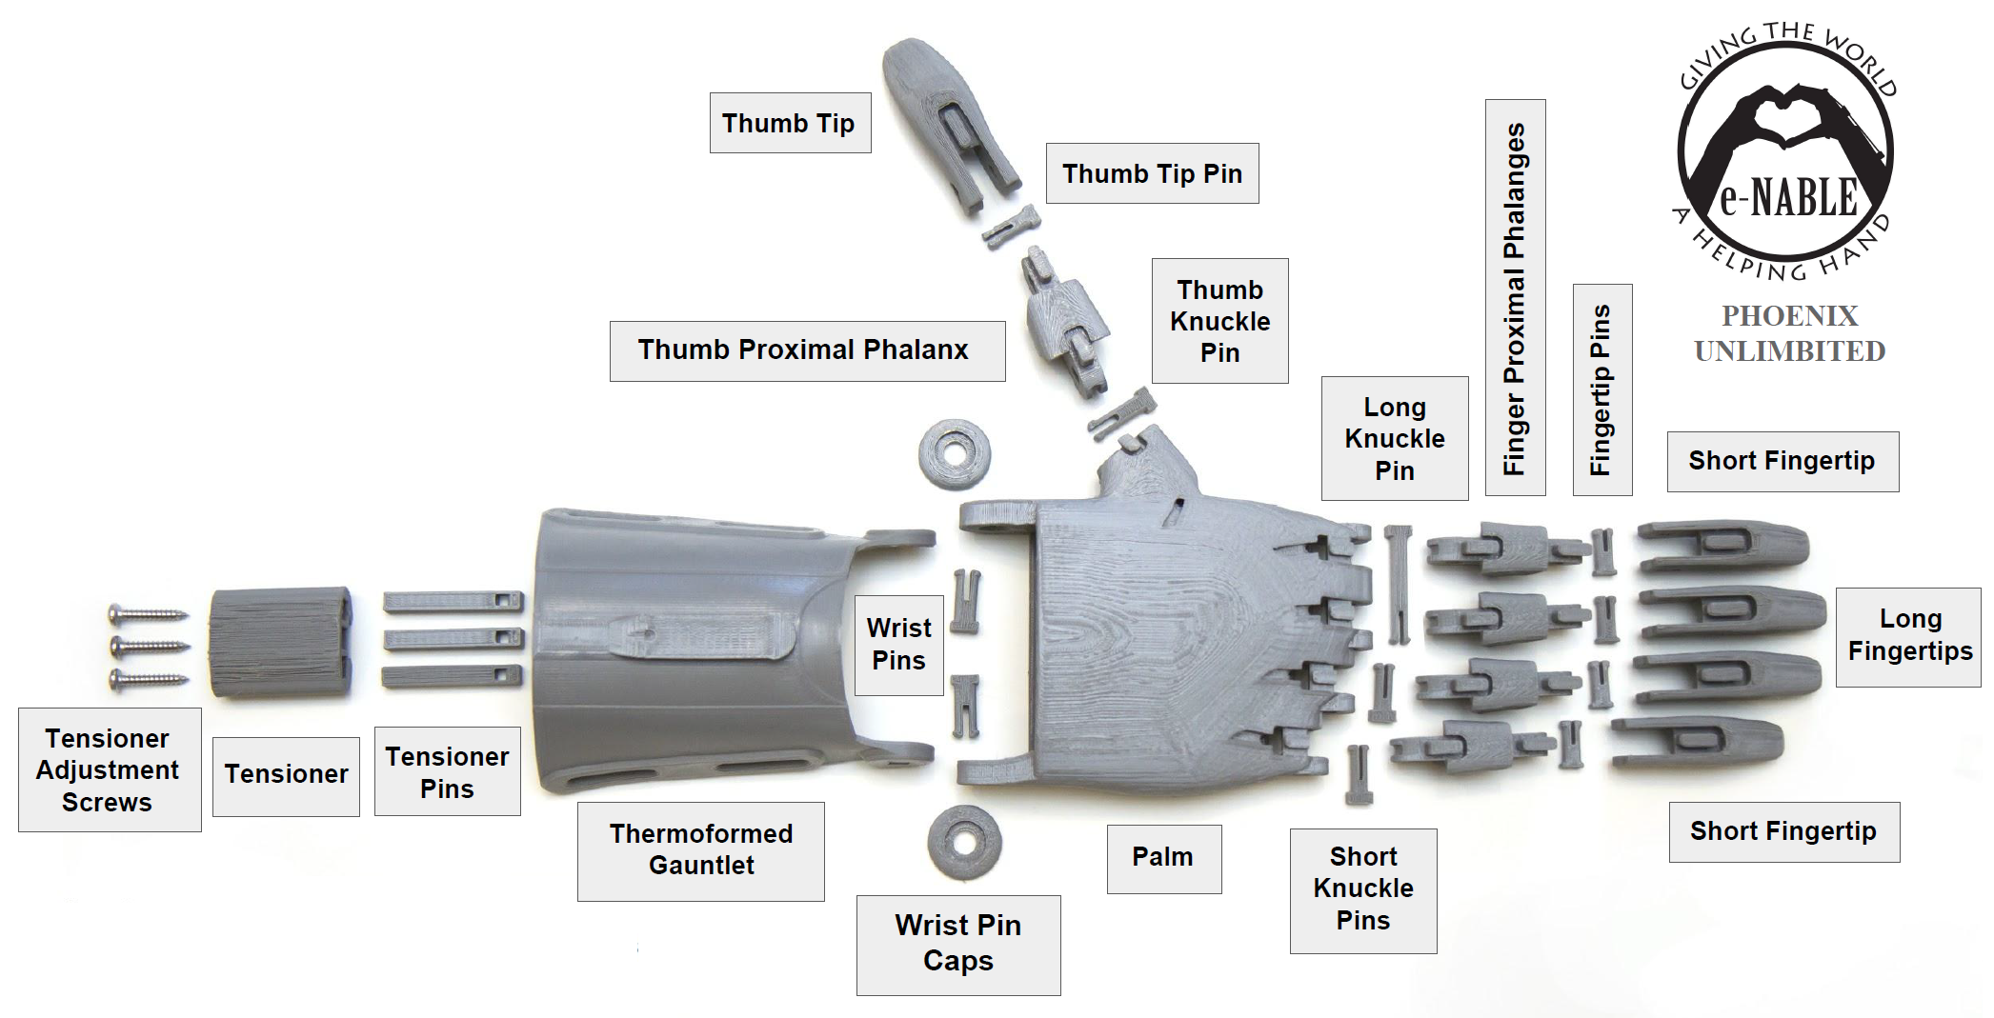


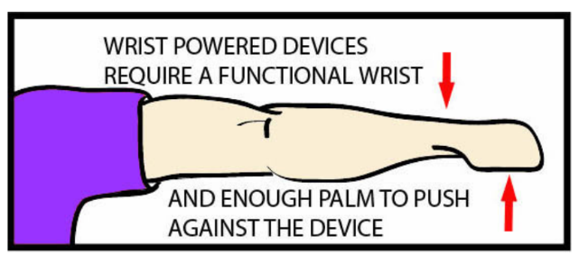
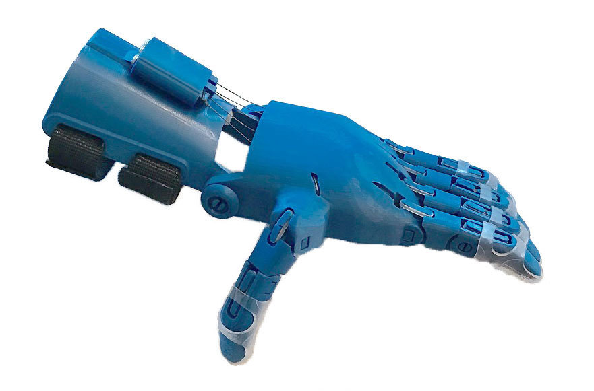

Project Inspiration
E-NABLE’s Unlimited Phoenix Hand Design
Notes:
Personal inspiration
Strong interest in prosthetics b/c of its ability to improve someone’s quality of life who has a missing limb
Exposure to mechanical design of a prosthetic
Unlimited Phoenix Hand Design:
Low-cost prosthetic
Strong grip strength
Avg. cost of materials less than $50
Wrist Powered Device intended for:
People without all their fingers, but still have a functional wrist that can bend at least 30 degrees in either direction
Need enough palm to push down against the device to make it work properly
My project:
Dimensions were tailored to my left wrist and about 1/3 of my palm

Slide 3
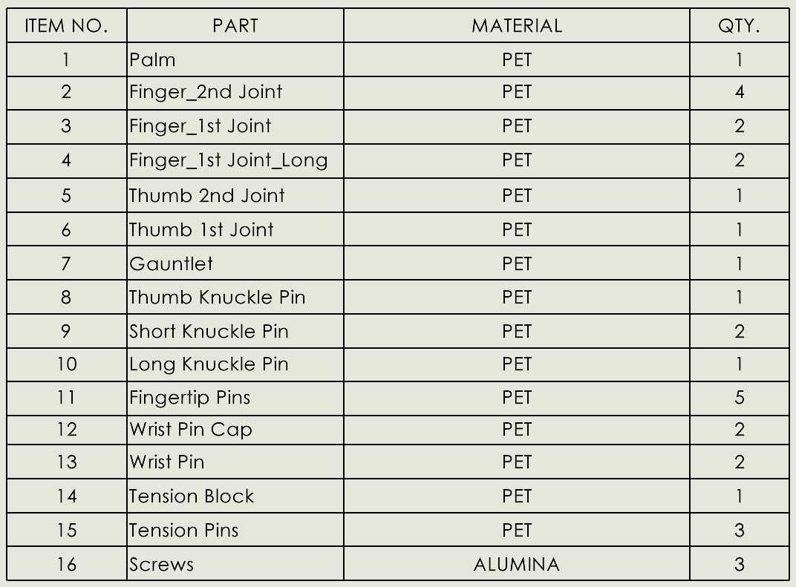
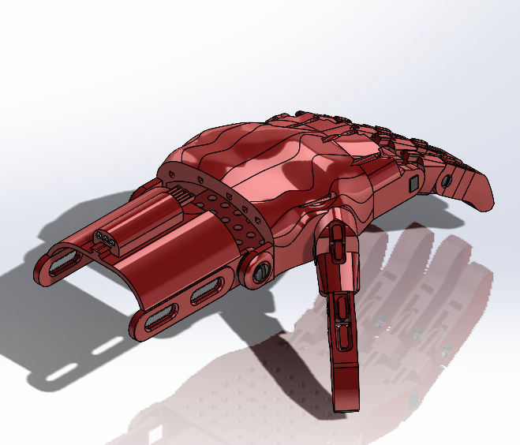
Final Design
Notes:
Weight: 1.12 lbs

Slide 4
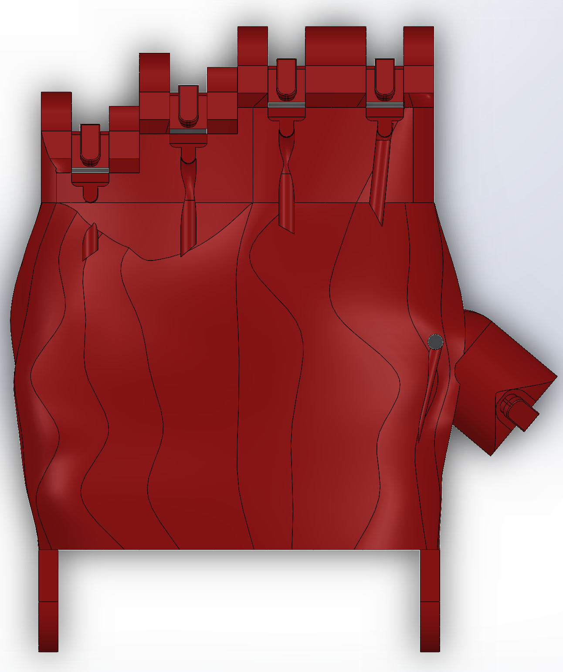
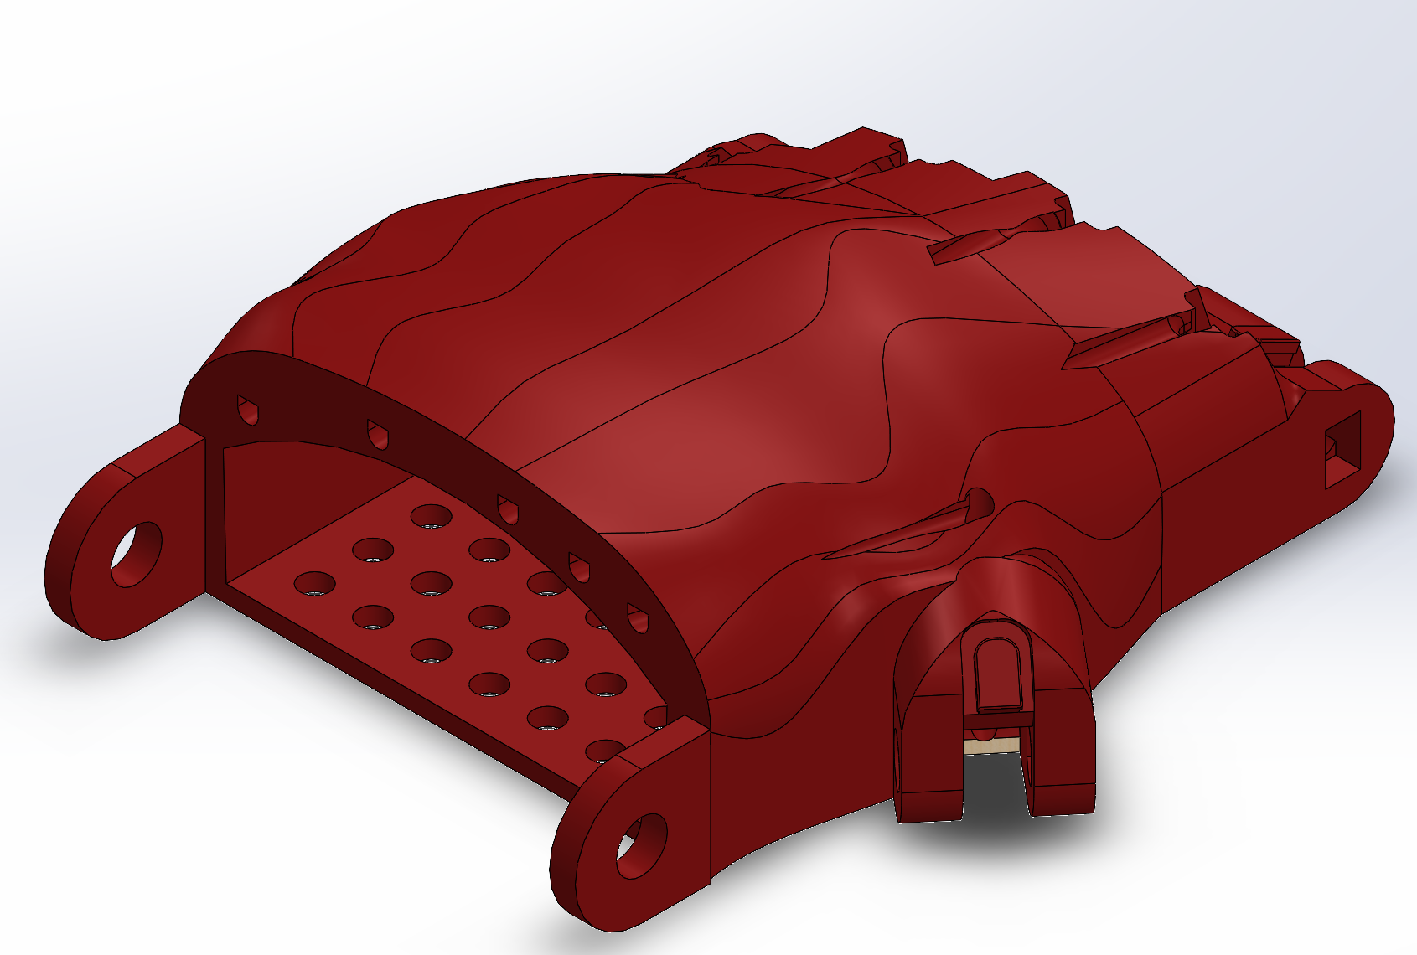
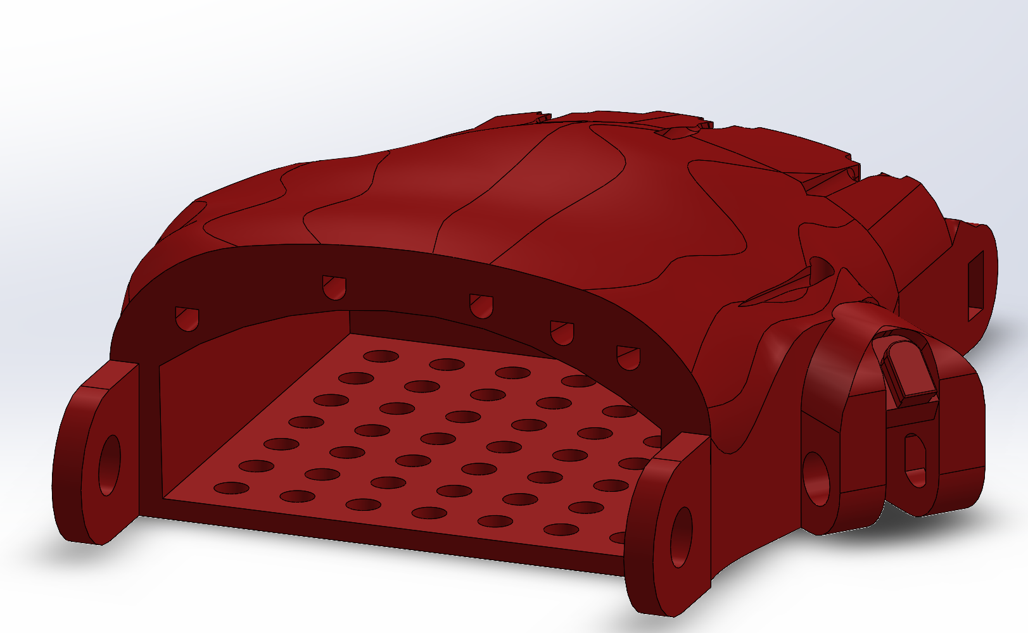
Part 1: Palm
Notes:
Difficulties

Slide 5
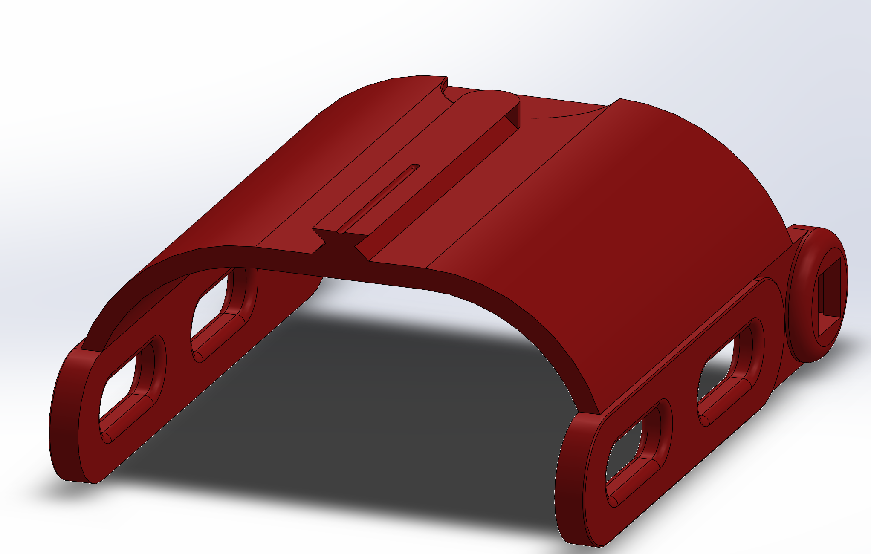
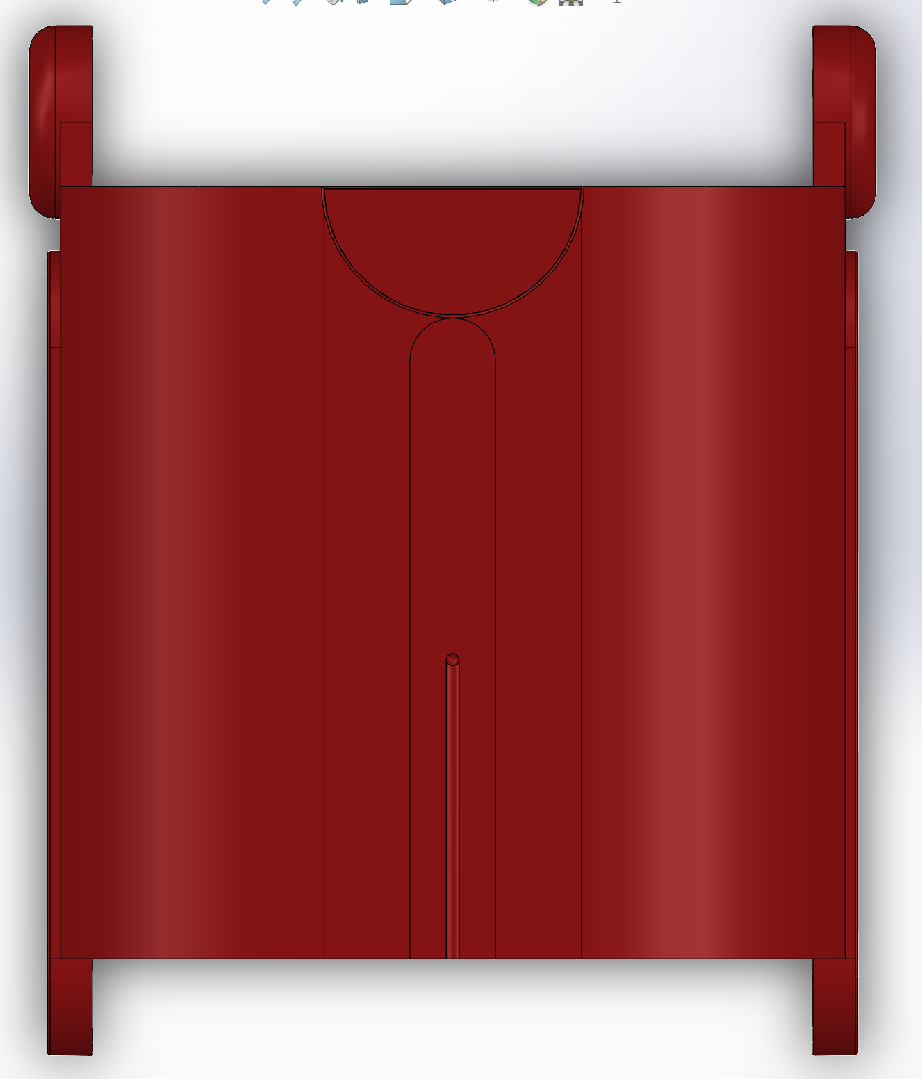
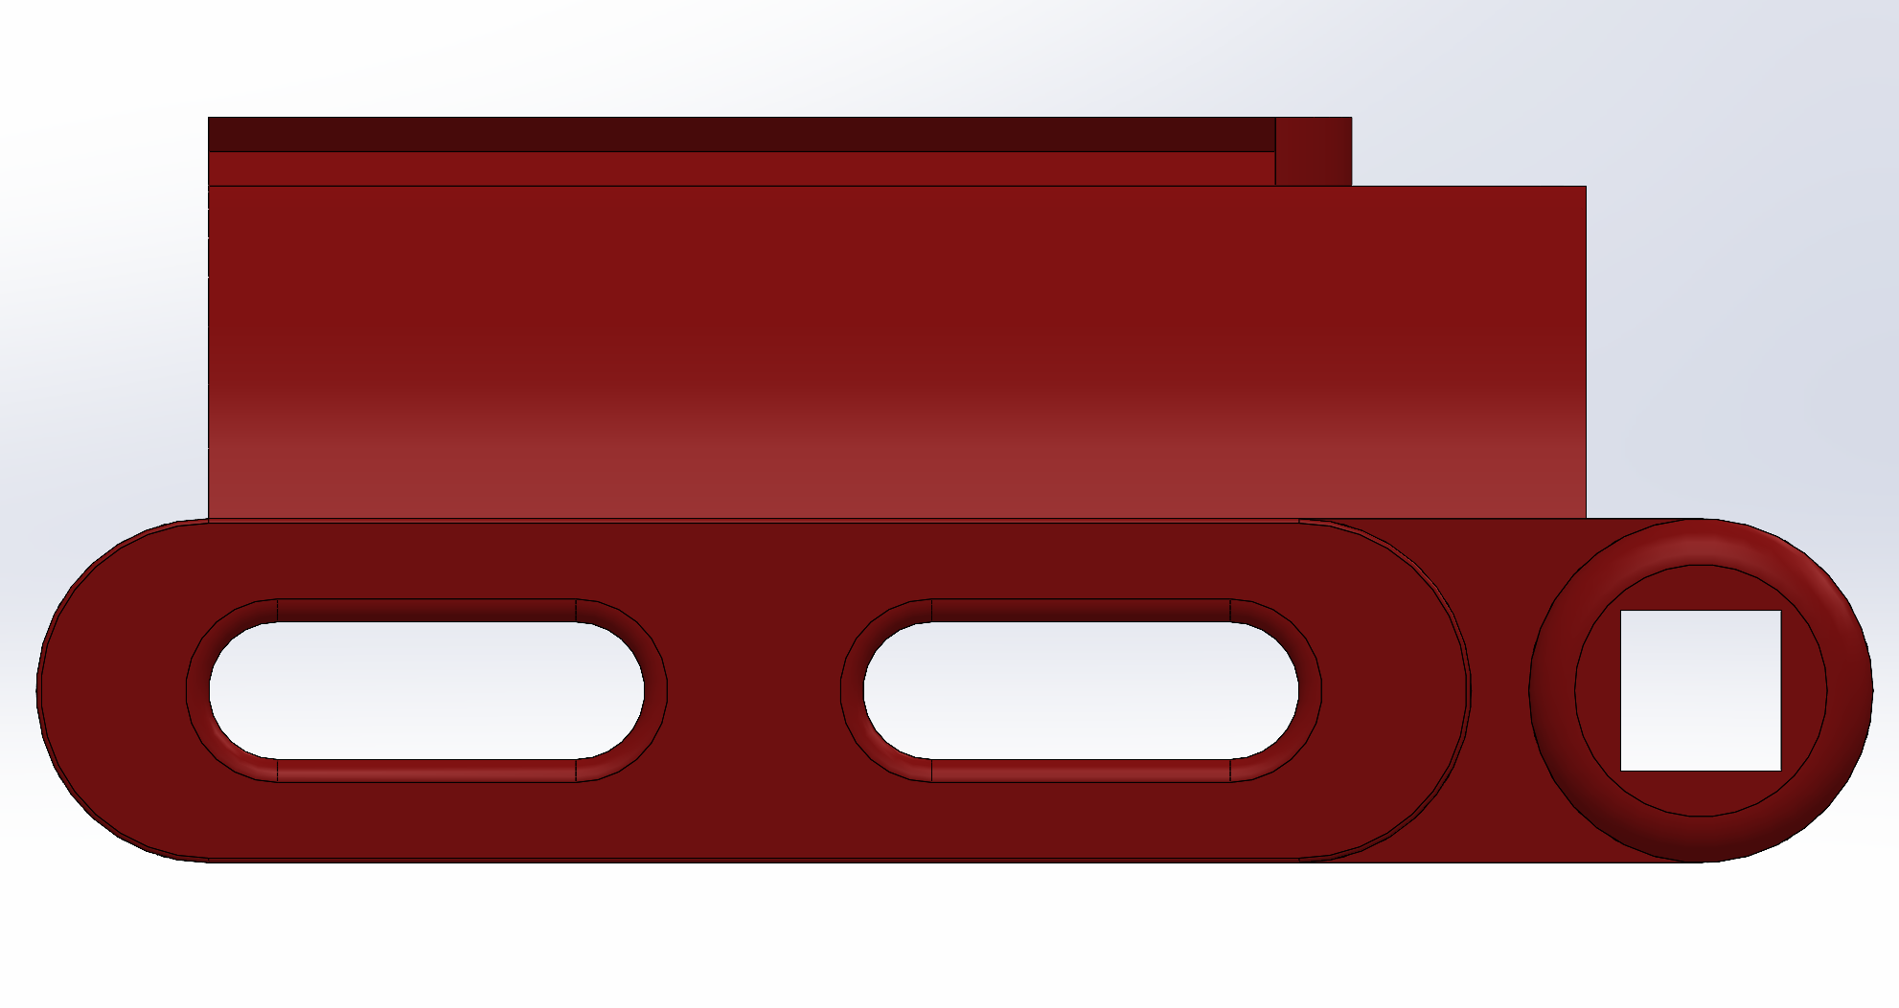
Part 2: Gauntlet
Notes:
Difficulties

Slide 6
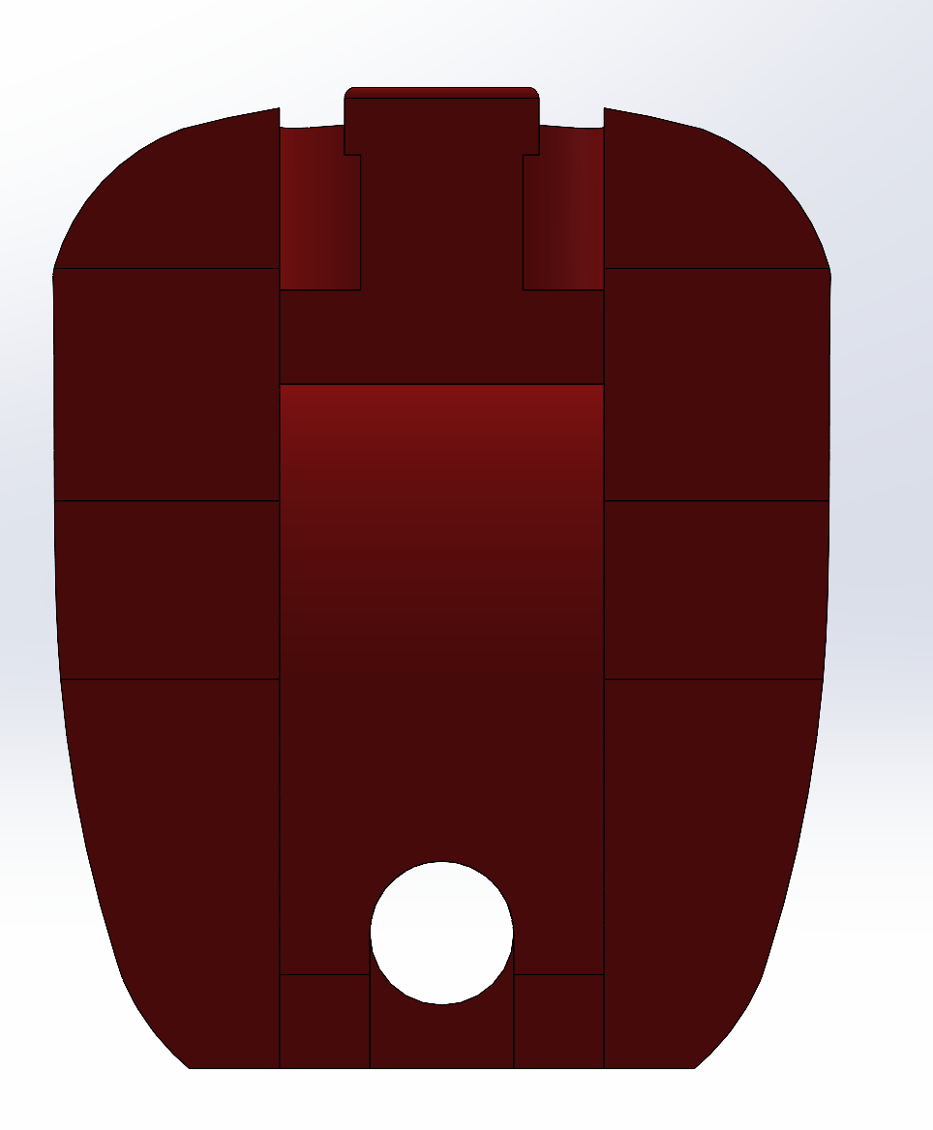
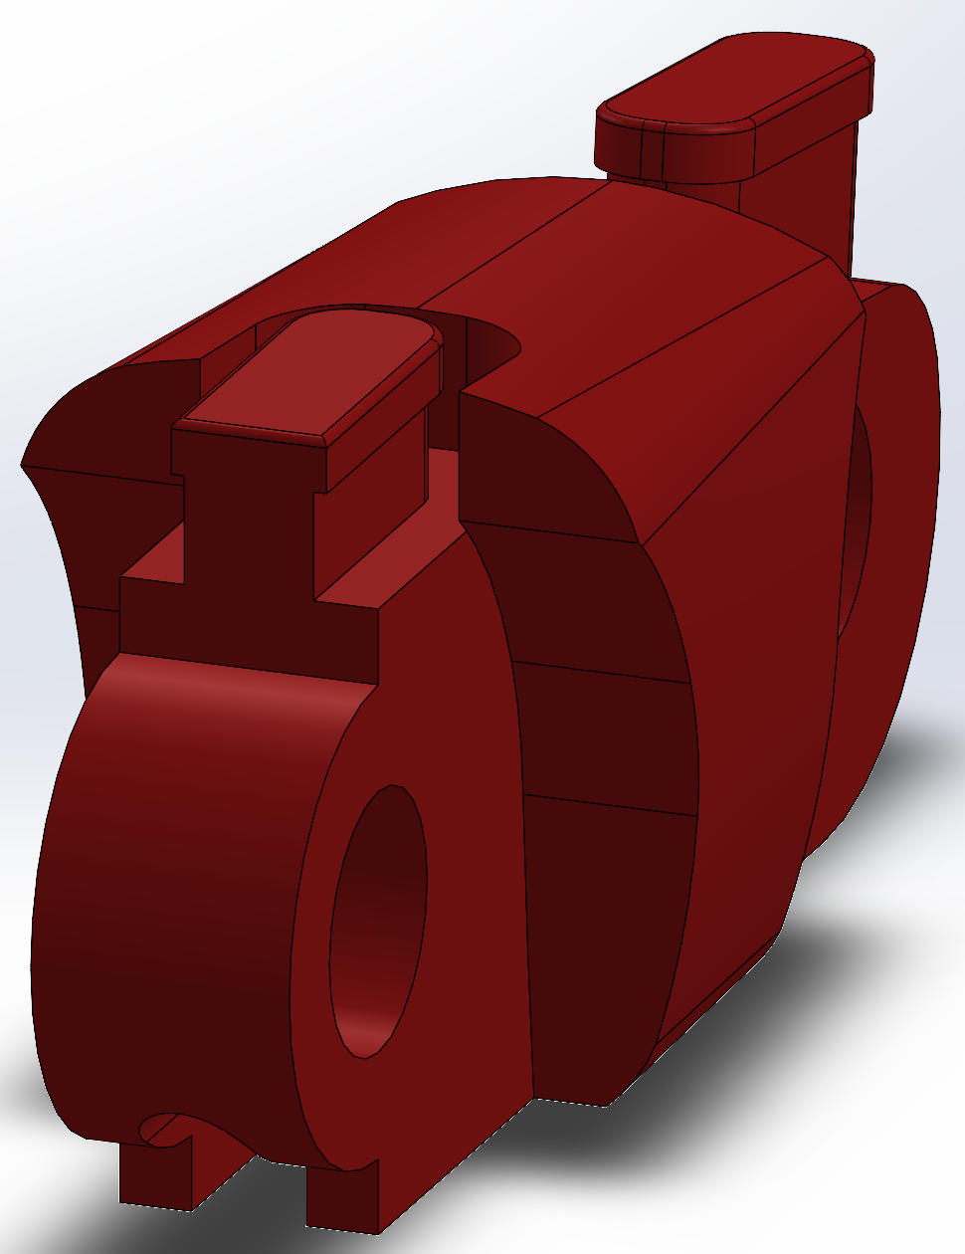
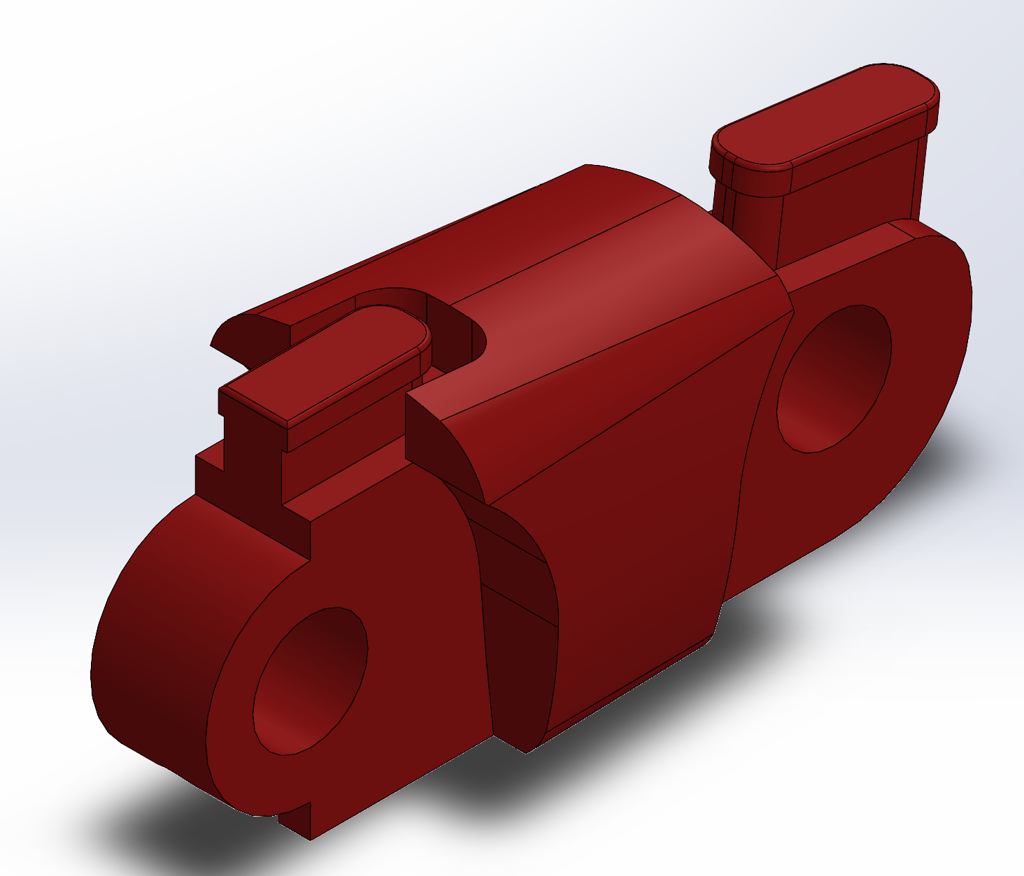
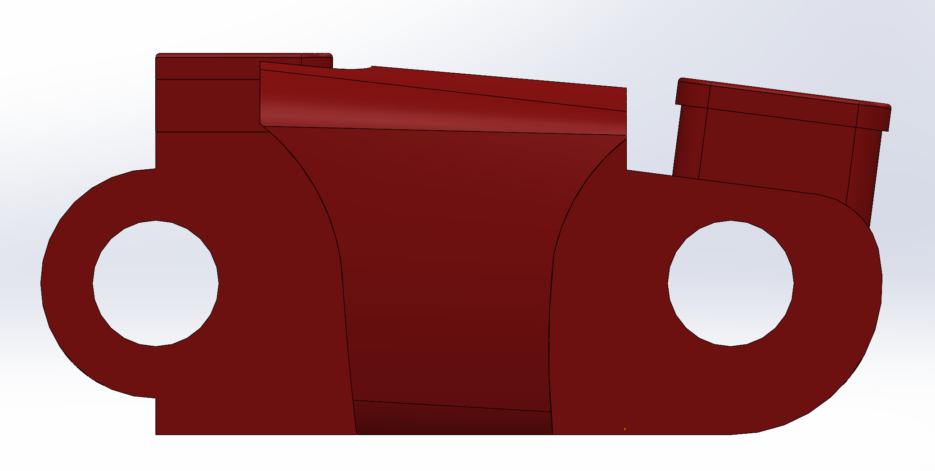
Part 3: Finger 2nd Joint
Notes:
Difficulties

Slide 7
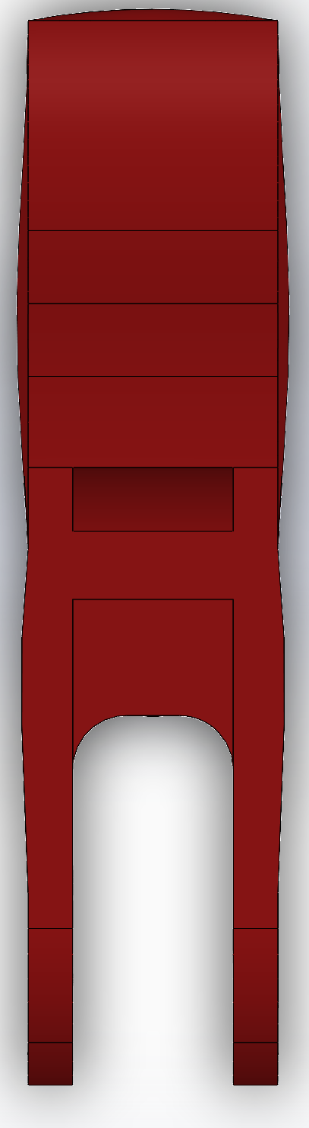
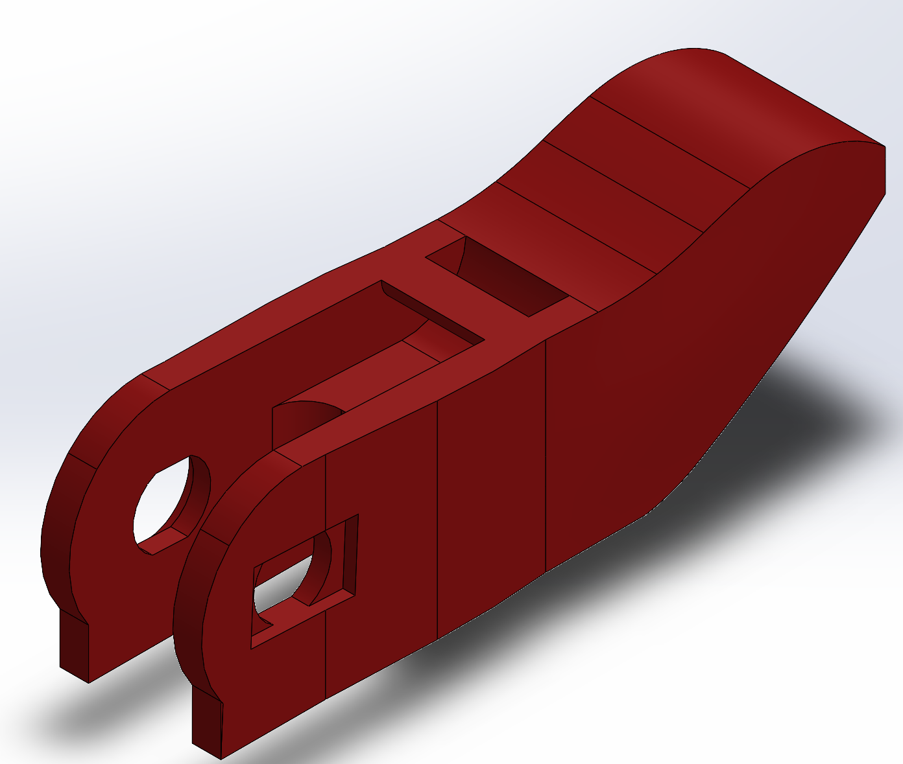
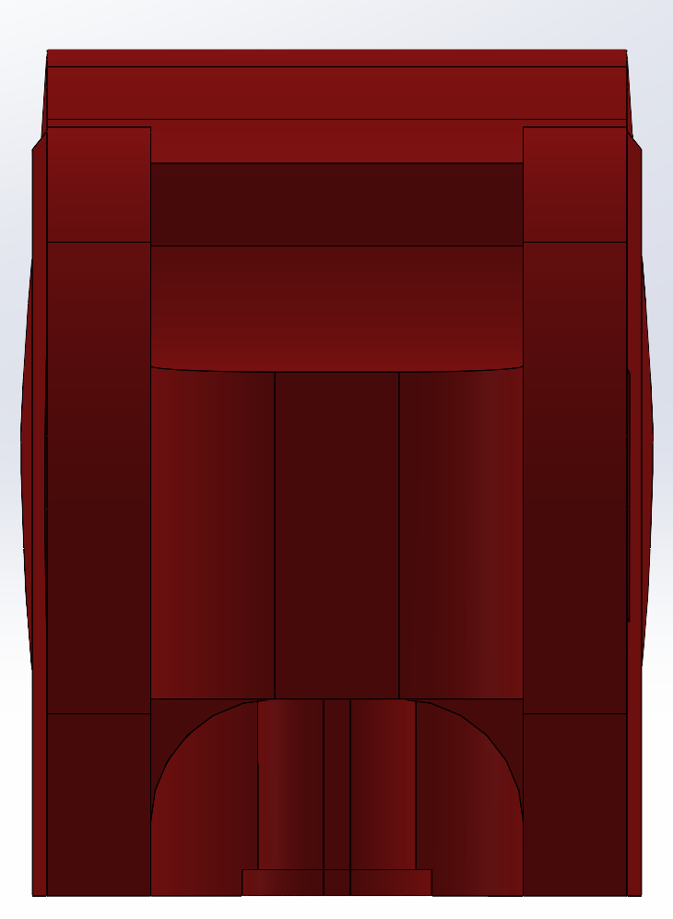
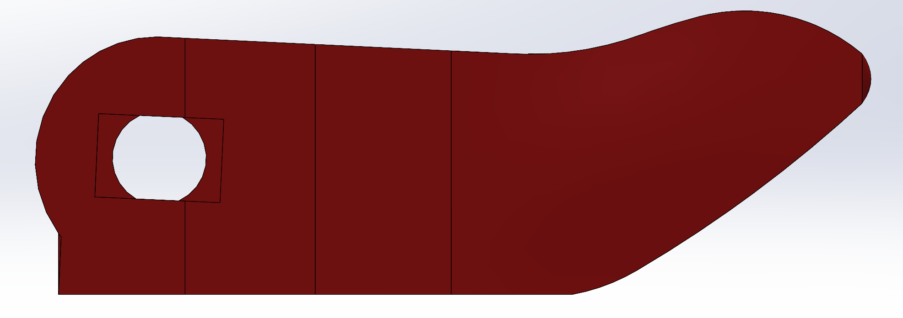
Part 4: Finger 1st Joint
Notes:
Difficulties

Slide 8
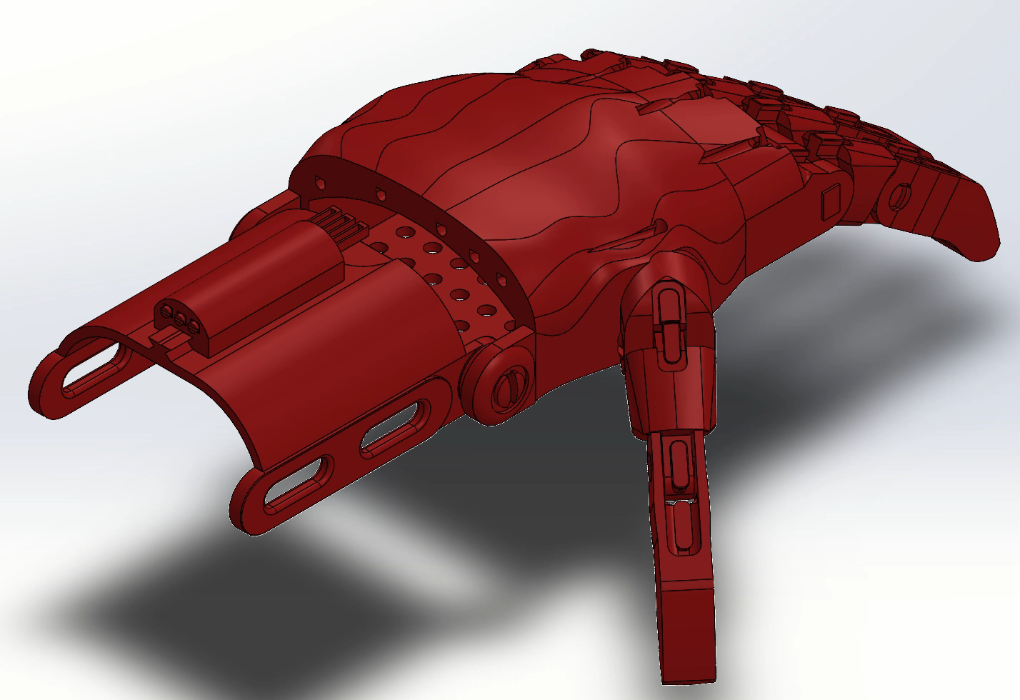
Animation of final assembly
Notes:
Discussion of the final assembly and how it all comes together (or moves if it’s a dynamic system)

Slide 9
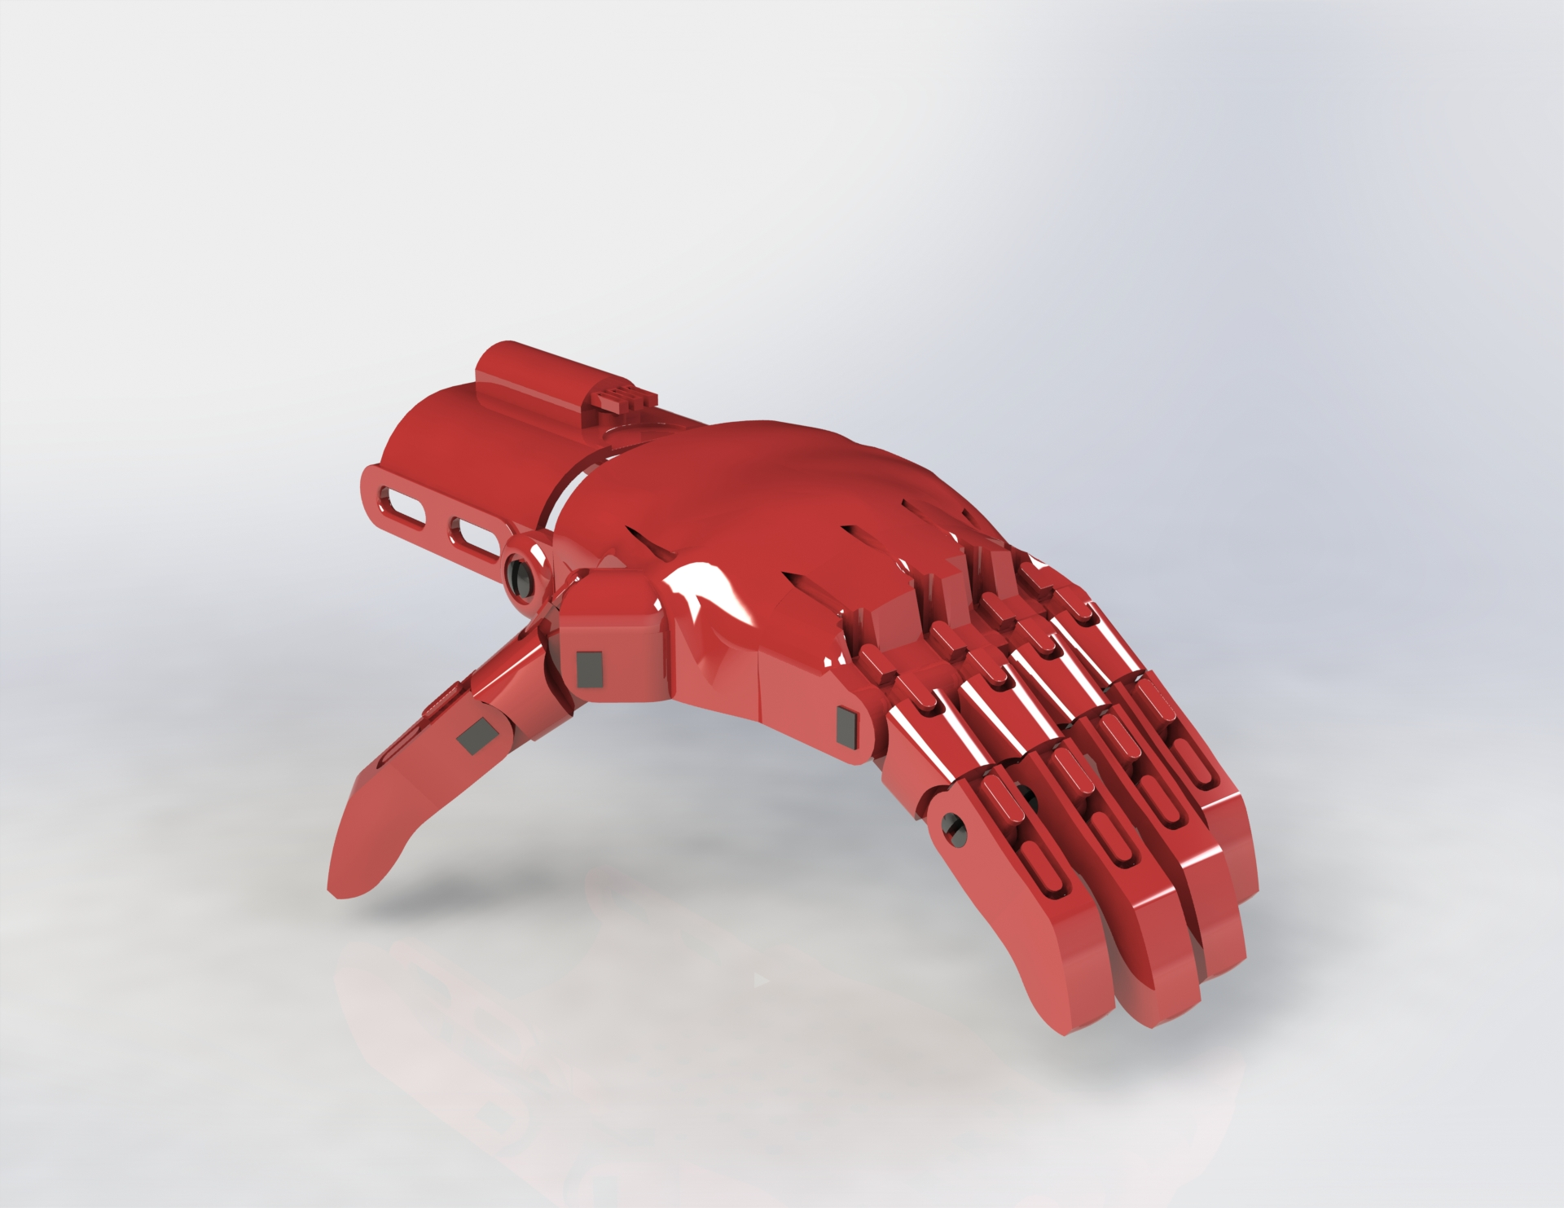
Photorealistic Rendering

